Slide 1
Relations and Functions
Shreyas M
B.Tech in ECE PES University Bangalore

Slide 2
Chapter Map
Section | Topic
1 | Intro
2 | Cartesian Product and Ordered pairs
3 | Relations
4 | Functions
5 | Some commonly used functions
6 | Algebra of functions
7 | Supplement (Elaboration on logarithmic function)

Slide 3
1 Introduction
Much of mathematics is about finding a pattern – a recognizable link between quantities that change.
In mathematics also, we come across many relations such as number m is less than number n, line l is parallel to line m, set A is a subset of set B.
Included: The concept of Cartesian Product and ordered pairs; Understanding ‘Relations’ from Cartesian products; Understanding ‘Functions’ from ‘Relations’ ; Some commonly used functions and more on logarithmic functions

Slide 4
2 Cartesian Product and Ordered pairs
Ordered Pairs : An ordered pair is a pair of two quantities which have a well defined connection between them. In general, an ordered pair is denoted by (A,B) where A and B are connected in a particular way. Note that A must belong to the domain set and B must belong to the codomain set. B is called the IMAGE of A.
Cartesian product : A cartesian product is the set of all ‘Ordered Pairs’ formed by the connection of two sets. In general, a cartesian product of two sets is denoted by
D X R={(A,B) : A ∈ D and B ∈ R } --------------- > read as “Cartesian product of D and R is the set of all ordered pairs (A,B) such that A belongs to D and R belongs to B. Here D is called domain and R is called codomain”
An important property:
“If D has ‘n’ elements and R has ‘m’ elements, D X R has n*m ordered pairs”
🔍Is Cartesian product Commutative? Why or why not?

Slide 5
Example
Let
S={♥️,♦️,♣️,♠️} --- Suits of a deck of cards.
V={A,2,3,4,5,6,7,8,9,10,J,Q,K} --- Values in a deck of cards.
Cartesian product is of the above sets is as follows:
D= S X V = {(A,B) : A is the suit of cards and B is the value of card}
Verification of property:
n(S)=4 ; n(V)=13 n(D)= 4 * 13 = 52 cards in the deck
It is quite clear that Cartesian product of S: a set of All suits of cards; and V: a set of all values a card can have; basically lists out all possible cards in the deck. Therefore the cartesian product is said to “SPAN” the entire dimensional space. Since we are assuming two properties in this example, a deck of cards is a “two-dimensional space.”

Slide 6
Deck of cards in roaster form
D=
{
(♥️,A),(♦️,A),(♣️,A),(♠️,A), (♥️,2),(♦️,2),(♣️,2),(♠️,2), (♥️,3),(♦️,3),(♣️,3),(♠️,3), (♥️,4),(♦️,4),(♣️,4),(♠️,4), (♥️,5),(♦️,5),(♣️,5),(♠️,5), (♥️,6),(♦️,6),(♣️,6),(♠️,6), (♥️,7),(♦️,7),(♣️,7),(♠️,7), (♥️,8),(♦️,8),(♣️,8),(♠️,8), (♥️,9),(♦️,9),(♣️,9),(♠️,9), (♥️,10),(♦️,10),(♣️,10),(♠️,10), (♥️,J),(♦️,J),(♣️,J),(♠️,J), (♥️,Q),(♦️,Q),(♣️,Q),(♠️,Q), (♥️,K),(♦️,K),(♣️,K),(♠️,K)
}
More properties of Cartesian product:
(a,b)=(c,d) <=> a=c ; b=d
A X (B U C) =(A X B) U (A X C)
A X (A ∩ B) =(A X B) ∩ (A X C)

Slide 7
3 Relations
A relation is a subset of cartesian product chosen such that the ordered pair is has the connection well-defined.
Note that All elements of codomain need not be used. The set of elements from codomain being used is called the Range of the Relation .
Example : Consider the example of X={1,2,3,4,5,6,7,8,9,10}
Let E be a relation such that
F: X→X --------- Read as F is a relation going from X to X
F={ (a,b) : b is a multiple of a}
F={
(1,1),(1,2),(1,3),(1,4),(1,5),(1,6),(1,7),(1,8),(1,9),(1,10),
(2,2),(2,4),(2,6),(2,8),(2,10),(3,3),(3,6),(3,9),(4,4),(4,8),
(5,5),(5,10),(6,6),(7,7),(8,8),(9,9),(10,10)
}
Note: Total number relation that can be formed between sets between A and B is n(A X B)

Slide 8
4 Functions
Definition of a function : A Function is a Relation in which every element in domain has ONLY ONE IMAGE in the codomain. The set of all images is called the Range of the function.
Example
F1: R→R
F1={(a,b) : b is a multiple of a} ----- F1 is not a function because ‘a’ can have infinite multiples (‘b’ is not unique for each value of ‘a’)
F2:R→R
F2={(x,y) : y=2x} ----- F2 is a function because ‘y’ is unique for every value of ‘x’.
f:D→C:
Y=f(x) ------------ read as “ ‘y’ is a function ‘f‘ of ‘x’ from domain D to codomain C with range R“
The class of function we deal in further slides is called ‘real function’ (with domain as R or subset of R) and ‘real-valued function’ (with codomain as R or subset of R).

Slide 9
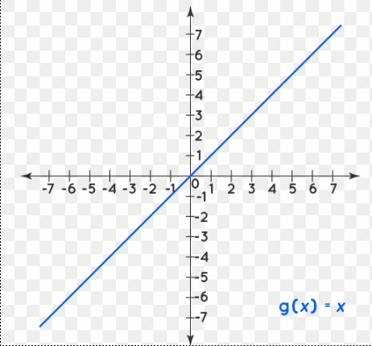
5 Some commonly used functions
Identity function
f:R→R such that
y=f(x)=x
Domain: R
Codomain: R
Range: R

Slide 10
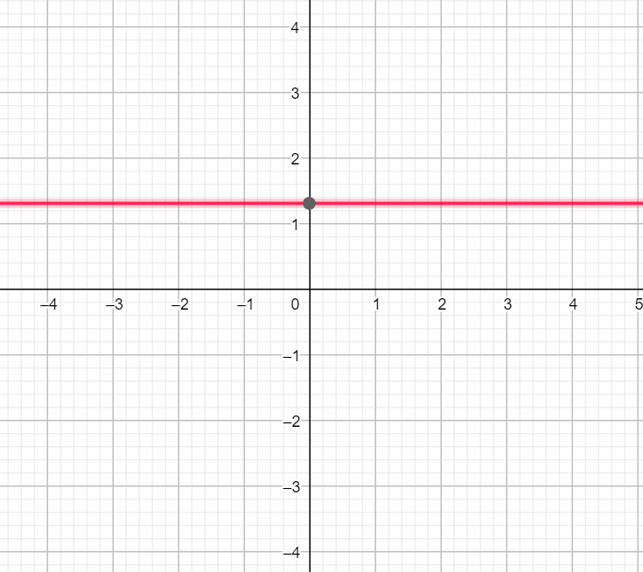
2. Constant function
f:R→R
y=f(x)=a (where a is a constant)
Domain : R
Codomain : R
Range : {a}

Slide 11
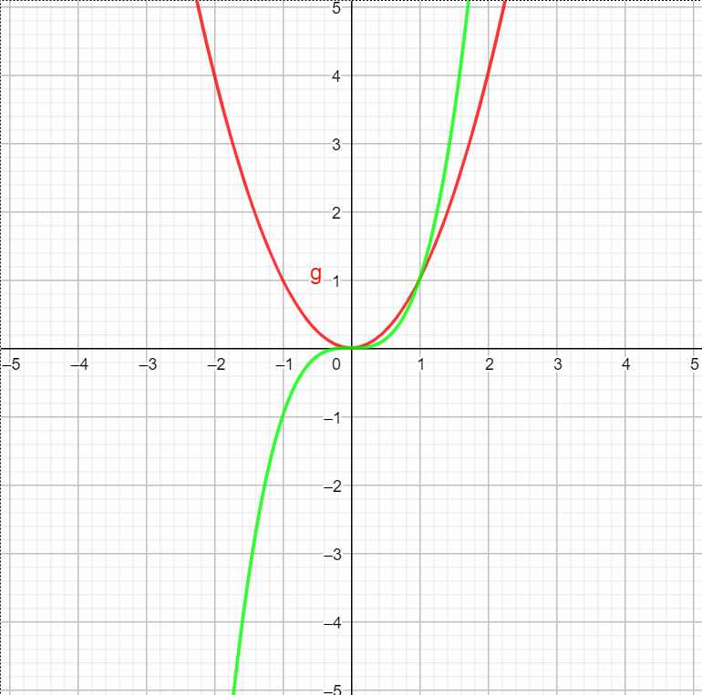
3. Polynomial function
f:R→R
y=f(x)= x³
f:R→R
y=f(x)= x²
Domain : R
Codomain : R
Range : R

Slide 12
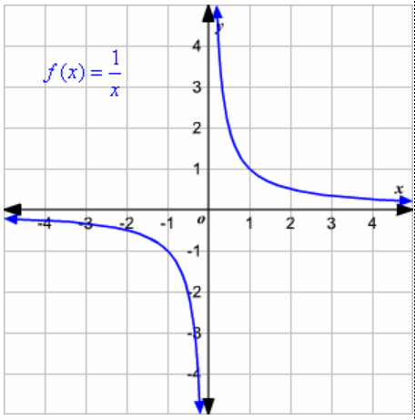

4.Rational function
h:R-{x:g(x)=0} →R
Y=h(x)=$\frac{f(x)}{g(x)}$
Domain : R-{x:g(x)=0}
Codomain : R
Range : R

Slide 13
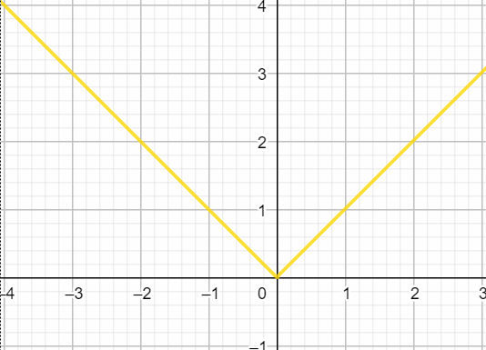

5. Modulus function
f:R→R
Y=|x|=f(x)=$f\left(x\right)=\left\{\begin{aligned}−&x, x<0 \\ &x, x≥0\end{aligned}\right.$
Domain : R
Codomain : R
Range : [0, ∞]

Slide 14
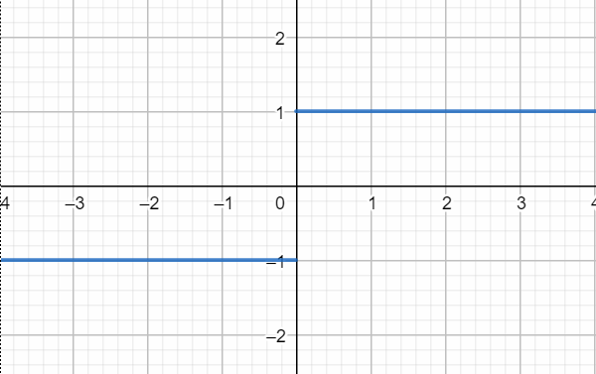

5. Signum Function
f:R-{0}→R
y = f(x) = $\frac{x}{|x|}$
Domain : R-{0}
Codomain : R
Range: { -1,1}

Slide 15
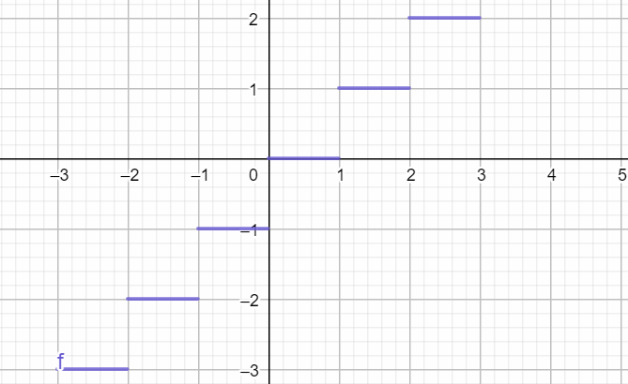

6. Greatest integer function
f:R→R
Y=f(x)=$\text{|_}\text{x}\text{_| }$
Domain : R
Codomain : R
Range : Z

Slide 16
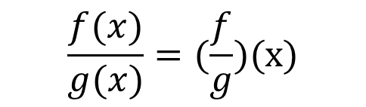

6 Algebra of functions
Sum/difference of functions
f(x) $\begin{matrix}+ \\ −\end{matrix}$ g(x) = (f $\begin{matrix}+ \\ −\end{matrix}$ g)(x)
Product of functions
f(x) . g(x) = fg(x)
Quotient of functions
$$\frac{f(x)}{g(x)}=(\frac{f}{g})(x)$$

Slide 17
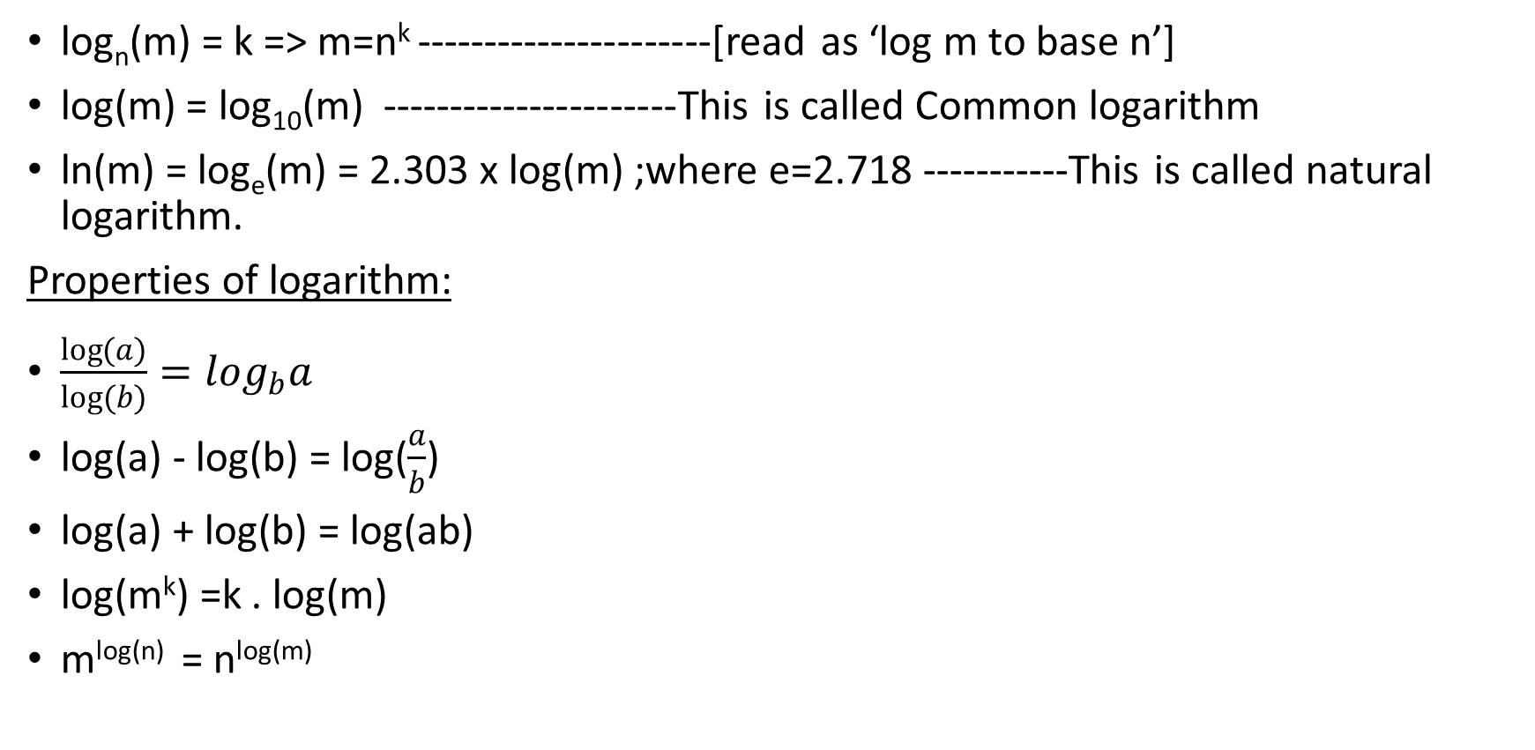
7 Elaboration on logarithmic function
log_{n}(m) = k => m=n^{k} ----------------------[read as ‘log m to base n’]
log(m) = log₁₀(m) ----------------------This is called Common logarithm
ln(m) = log_{e}(m) = 2.303 x log(m) ;where e=2.718 -----------This is called natural logarithm.
Properties of logarithm:
$\frac{\log{(a)}}{log(b)}=\log_{b}a$
log(a) - log(b) = log($\frac{a}{b}$)
log(a) + log(b) = log(ab)
log(m^{k}) =k . log(m)
m^{log(n)} = n^{log(m)}

Slide 18
Thank you
Shreyas M
B.Tech in ECE PES University Bangalore

